Slide 1
恶意代码分析与防治技术 第12章 隐蔽执行技术
（Covert Malware Lauching）
王志
zwang@nankai.edu.cn
南开大学 网络空间安全学院
2023-2024学年

Slide 2

主观题
10分
黑客有哪些方法可以隐蔽的执行恶意代码，使被感染的用户难以发现有恶意代码被执行？
作答

Slide 3
知识点
启动器（Launchers）
进程注入（Process Injection）
重点：DLL注入、直接注入
进程替换（Process Replacement）
难点：Suspended State
Hook注入（Hook Injection）
难点：Local Hook、Remote Hook
Detours技术
难点：R77
APC注入（APC Injection）
难点：Alertable State

Slide 4
启动器（Launchers）

Slide 5
Purpose of a Launcher
Sets itself or another piece of malware
For immediate or future covert execution
Conceals malicious behavior from the user

Slide 6
Purpose of a Launcher
Usually contain the malware they're loading
An executable or DLL in its own resource section or PE overlay.
Normal items in the resource section
Icons, images, menus, strings

Slide 7
Encryption or Compression
The resource section may be encrypted or compressed (without the second PE header)
Resource extraction will use APIs like
FindResource
LoadResource
SizeofResource
Often contains privilege escalation code

Slide 8
多选题
10分
启动器（Launcher）的功能包括哪些？
A
解密
B
隐蔽启动
C
权限提升
D
解压缩
提交

Slide 9
进程注入（Process Injection）

Slide 10
主观题
10分
讨论题：什么是进程注入（Process Injection）？
正常使用主观题需2.0以上版本雨课堂
作答

Slide 11
进程注入（Process Injection）
The most popular covert launching process
Inject code into a running process
Conceals malicious behavior
May bypass firewalls and other process-specific security mechanisms
常见的API函数:
VirtualAllocEx to allocate space
WriteProcessMemory to write to it

Slide 12
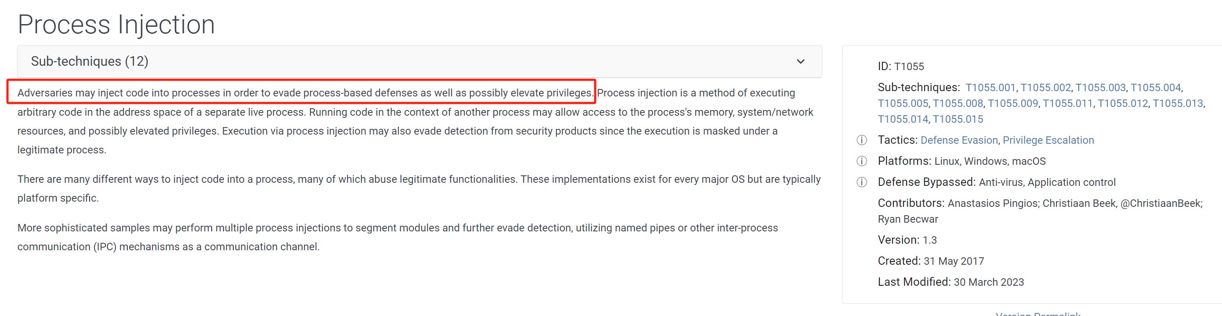
进程注入

Slide 13
进程注入
DLL注入（DLL Injection）
直接注入（Direct Injection）

Slide 14
DLL 注入
The most commonly used covert launching technique
Inject code into a remote process that calls LoadLibrary
Forces the process to load a malicious dll in the context of that process
On load, the OS automatically calls DLLMain which contains the malicious code

Slide 15
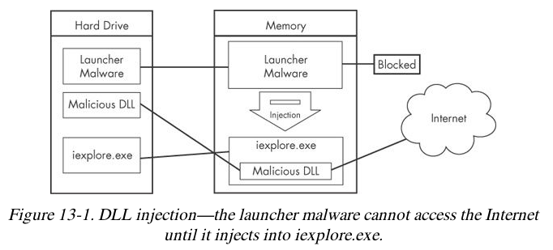
获取权限
Malware code has the same privileges as the code it is injected into

Slide 16
进程遍历
Search for the injection target
CreateToolhelp32Snapshot
Process32First
Process32Next
Retrieve the process identification(PID)
Obtain the handle
OpenProcess

Slide 17
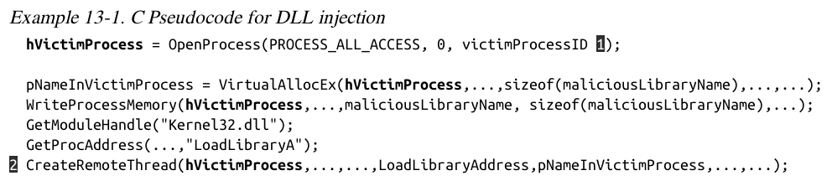
创建远程线程
CreateRemoteThread uses 3 parameters
Process handle hProcess
Starting point lpStartAddress (LoadLibrary)
Argument lpParameter Malicious DLL name
VirtualAllocEx, WriteProcessMemory

Slide 18
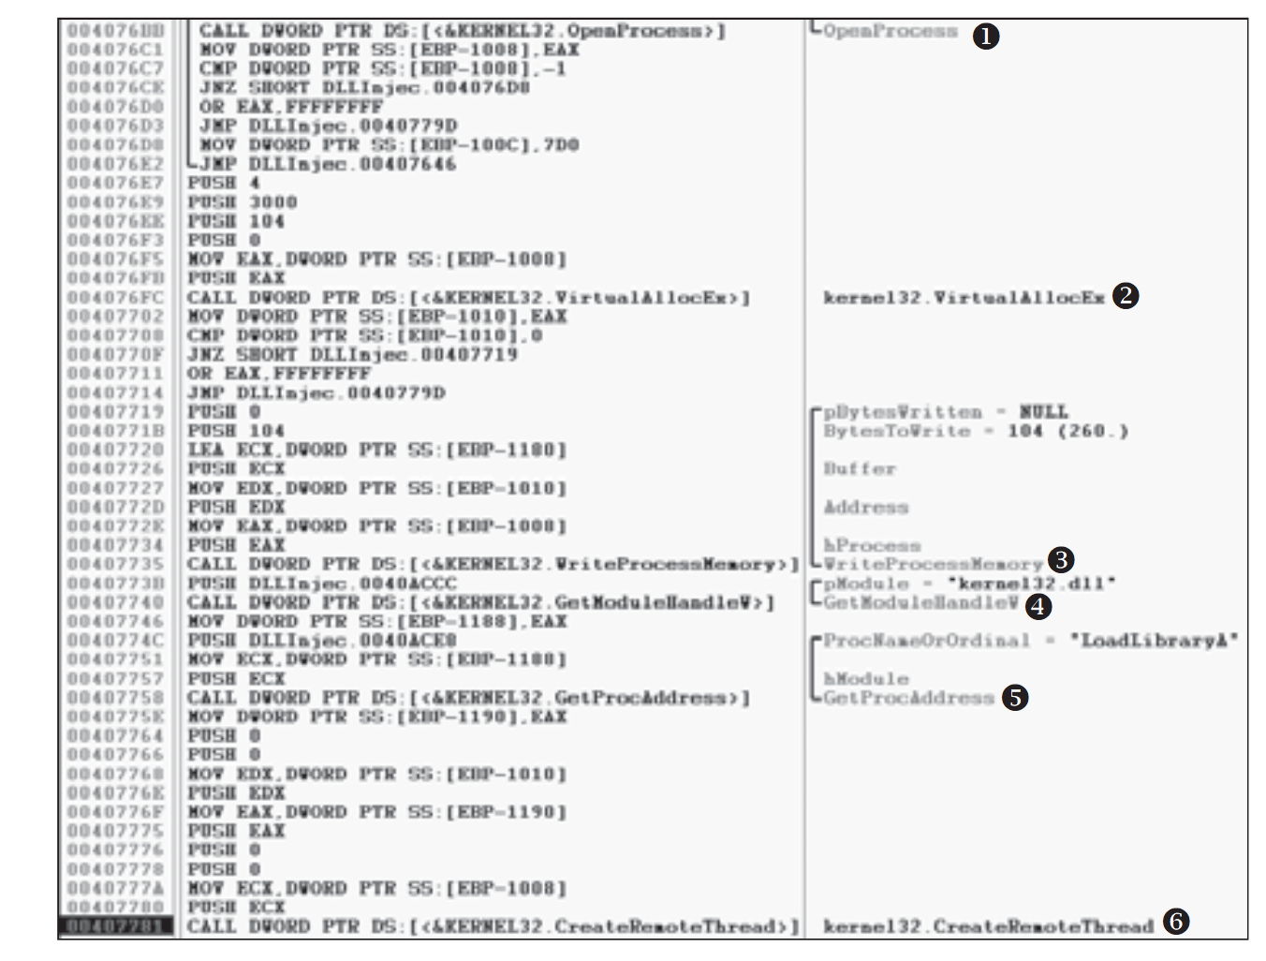

Slide 19
DLL 注入
For malware analysts
Find the victim process name
Find the malicious DLL name
Recognize injection code pattern

Slide 20
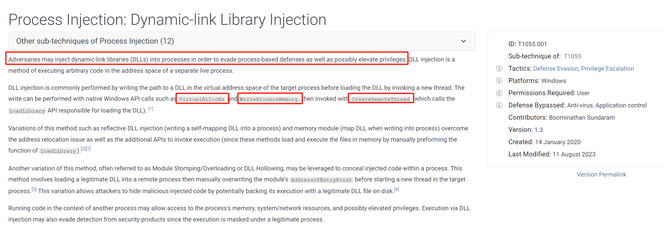
DLL注入

Slide 21
直接注入
Injects code directly into the remote process
Without using a DLL
Requires a lot of customized code
Difficult to write without negatively impact to host process
shellcode

Slide 22
直接注入
VirtualAllocEx
WriteProcessMemory
CreateRemoteThread
Compiled code
LoadLibrary
GetProcessAddress

Slide 23
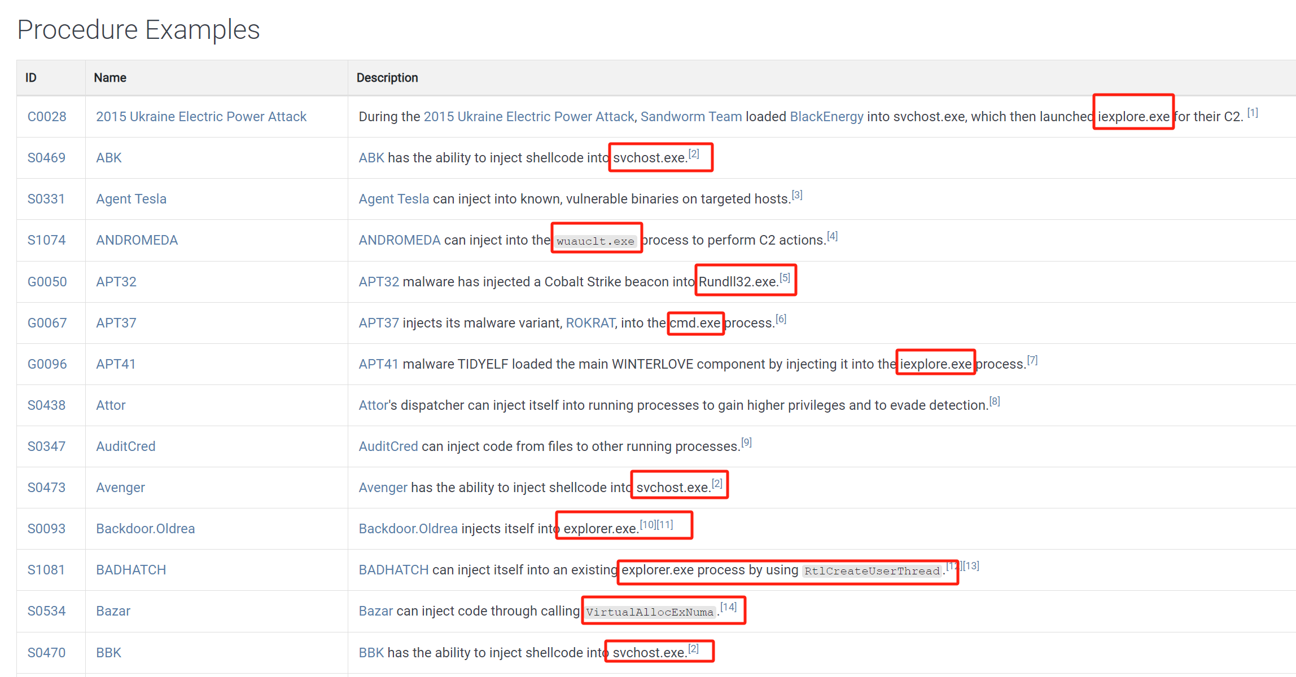
进程注入

Slide 24
多选题
10分
进程注入的优点有哪些？
A
获得被注入进程的权限
B
伪装恶意行为
C
可以有效穿透防火墙、躲避检测工具
D
影响被注入进程的正常执行
提交

Slide 25
多选题
10分
进程注入需要用到的API函数有哪些？
A
VirtualAllocEx
B
WriteProcessMemory
C
CreateRemoteThread
D
OpenProcess
提交

Slide 26
投票
最多可选1项
恶意代码通常选择DLL注入还是直接注入？
A
DLL注入
B
直接注入
提交

Slide 27
主观题
10分
如何检测进程的注入？
作答

Slide 28
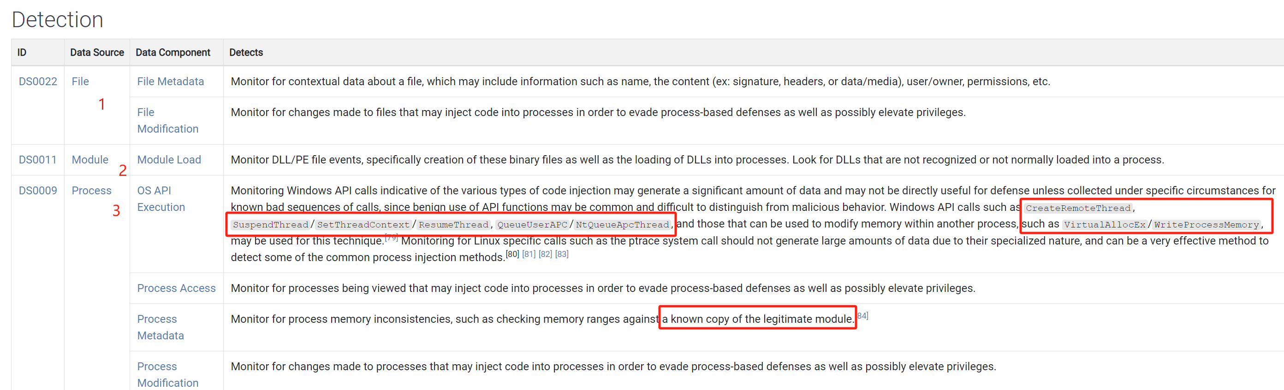
检测进程注入

Slide 29
主观题
10分
如何阻止或者缓解进程注入？
作答

Slide 30
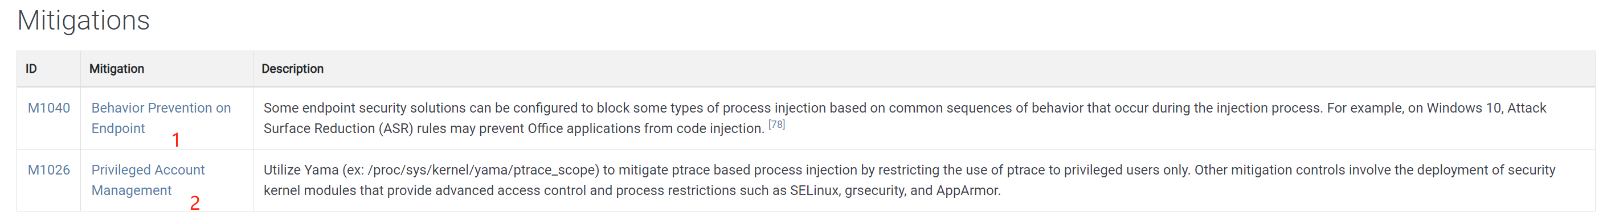
缓解进程注入

Slide 31
进程替换（Process Replacement）

Slide 32
主观题
10分
讨论题：什么是进程替换（Process Replacement）？与进程注入有什么区别。
正常使用主观题需2.0以上版本雨课堂
作答

Slide 33
进程替换
Replace the victim process’s memory space with malicious executable
Disguises malware as a legitimate process
Avoids risk of crashing a process with process injection
Malware gains the privileges of the process it replaces
Commonly replaces svchost.exe

Slide 34
Suspended State
In a suspended state, the process is loaded into memory but the primary thread is suspended
So malware can overwrite its code before it runs
This uses the CREATE_SUSPENDED value in the dwCreationFlags parameter in a call to the CreateProcess function

Slide 35
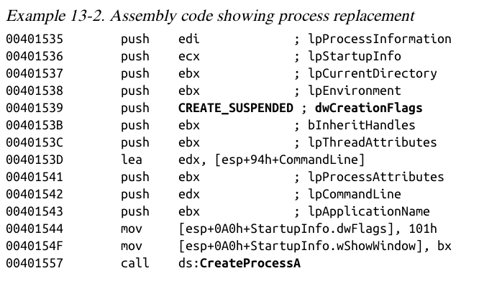

Slide 36
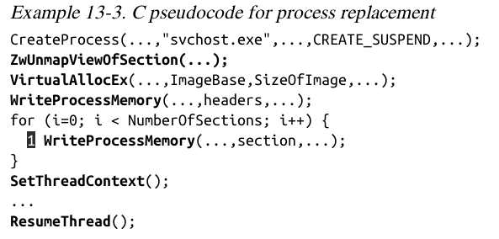
ZwUnmapViewOfSection releases all memory pointed to by a section
VirtualAllocEx allocates new memory
WriteProcessMemory puts malware in it

Slide 37
SetThreadContext restores the victim process's environment and sets the entry
ResumeThread runs the malicious code

Slide 38
进程替换
Bypass firewalls
Bypass intrusion prevention systems(IPSs)
From the process list, see only the original binary’s path and known binary executable
with no idea that it was replaced.

Slide 39
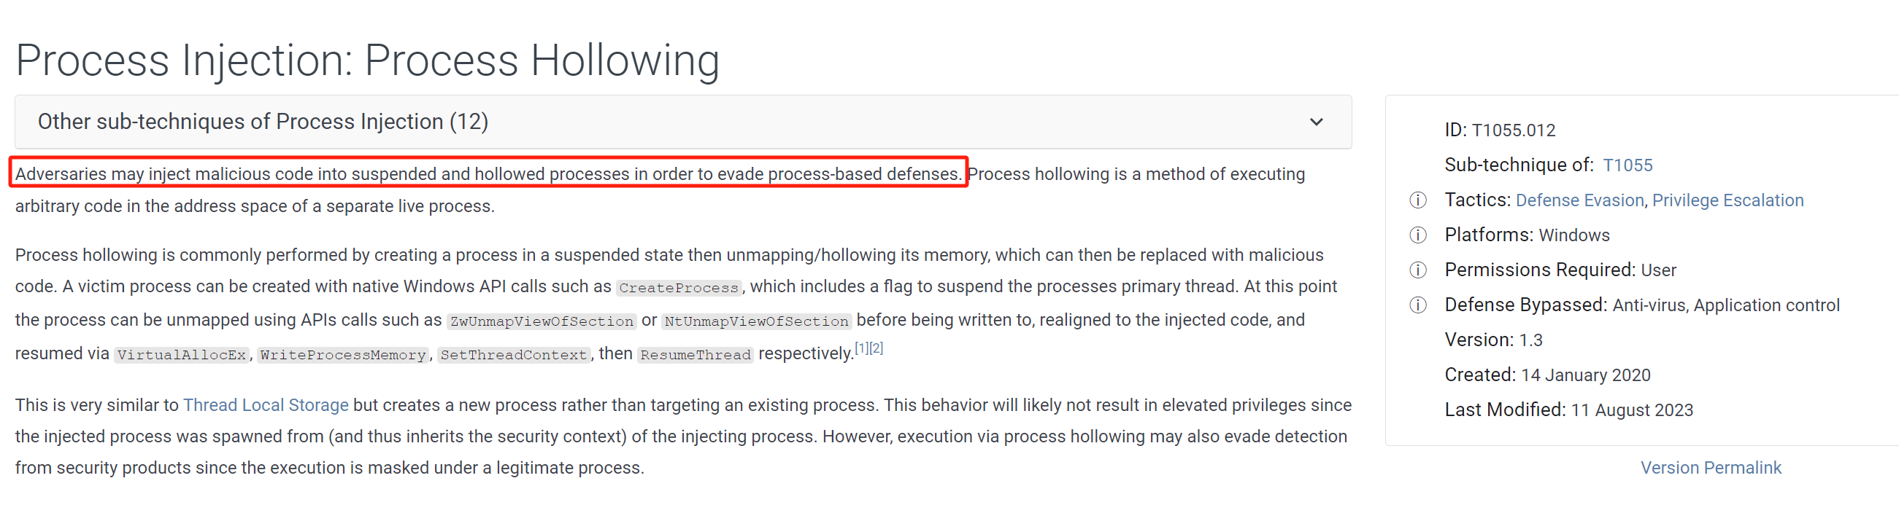
进程替换

Slide 40
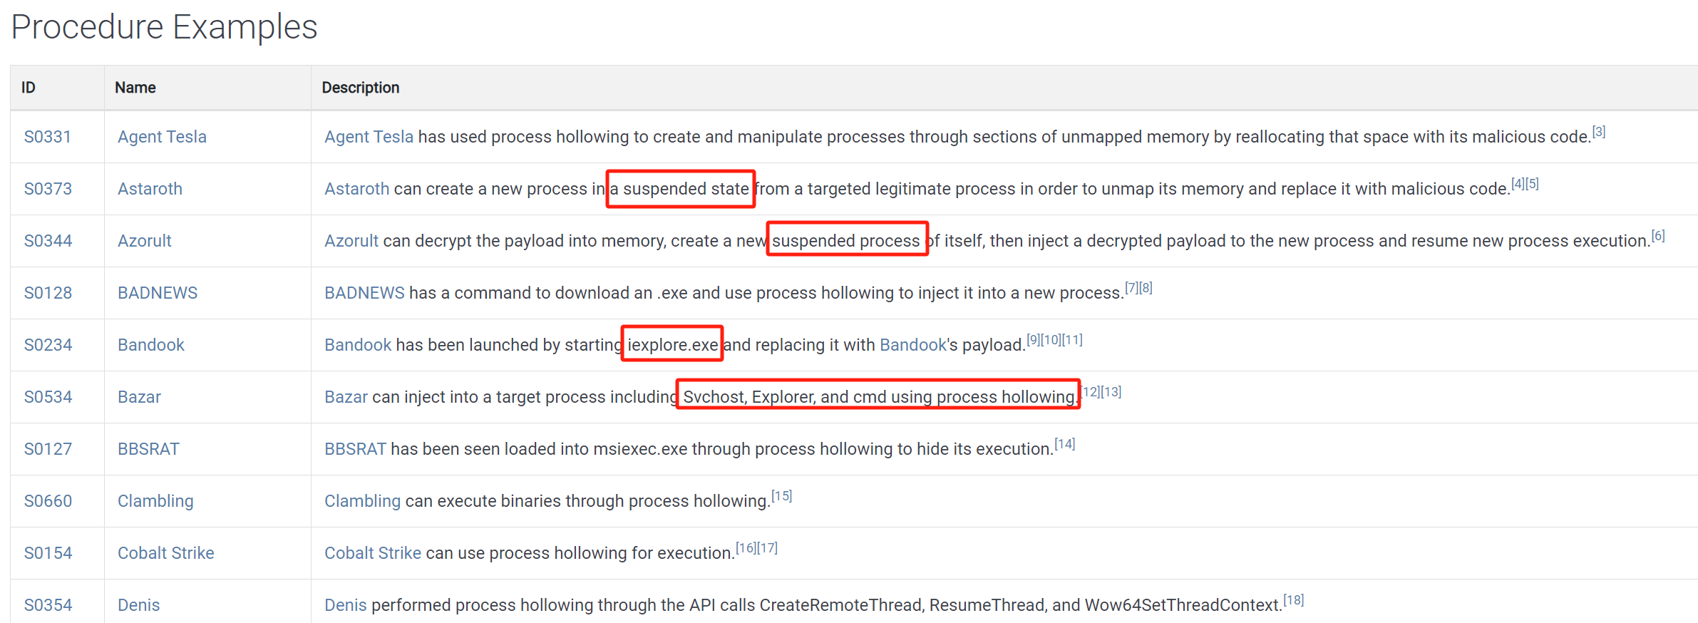
进程替换

Slide 41
单选题
10分
以下哪项需要用到进程的Suspended状态？
A
Privilege escalation
B
Process replacement
C
DLL injection
D
Direct injection
提交

Slide 42
单选题
10分
以下哪项技术需要大量的定制化代码（customized code）?
A
Privilege escalation
B
Process replacement
C
DLL injection
D
Direct injection
提交

Slide 43
单选题
10分
以下哪项技术需要调用FindResource函数?
A
Privilege escalation
B
Process replacement
C
DLL injection
D
Direct injection
E
Resource extraction
提交

Slide 44
多选题
10分
以下哪项技术需要调用CreateRemoteThread 函数?
A
Privilege escalation
B
Process replacement
C
DLL injection
D
Direct injection
E
Resource extraction
提交

Slide 45
主观题
10分
如何检测和缓解进程替换攻击？
作答

Slide 46
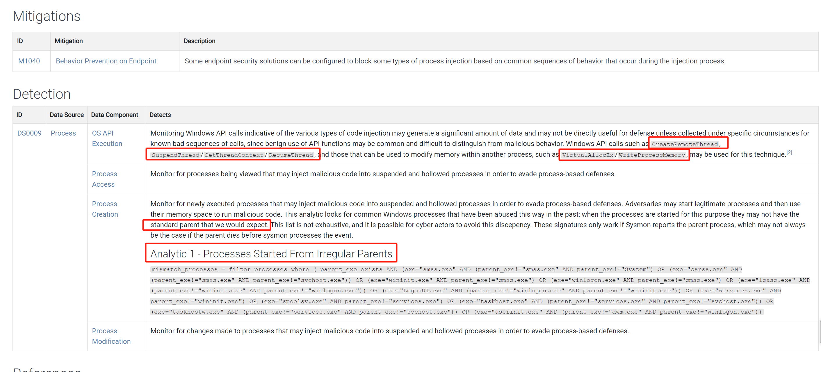
进程替换攻击

Slide 47
投票
最多可选1项
进程替换是否只能对新创建的进程进行替换？ 已经运行的进程是否可以进行替换？
A
可以
B
不可以
C
不知道
D
应该可以
提交

Slide 48
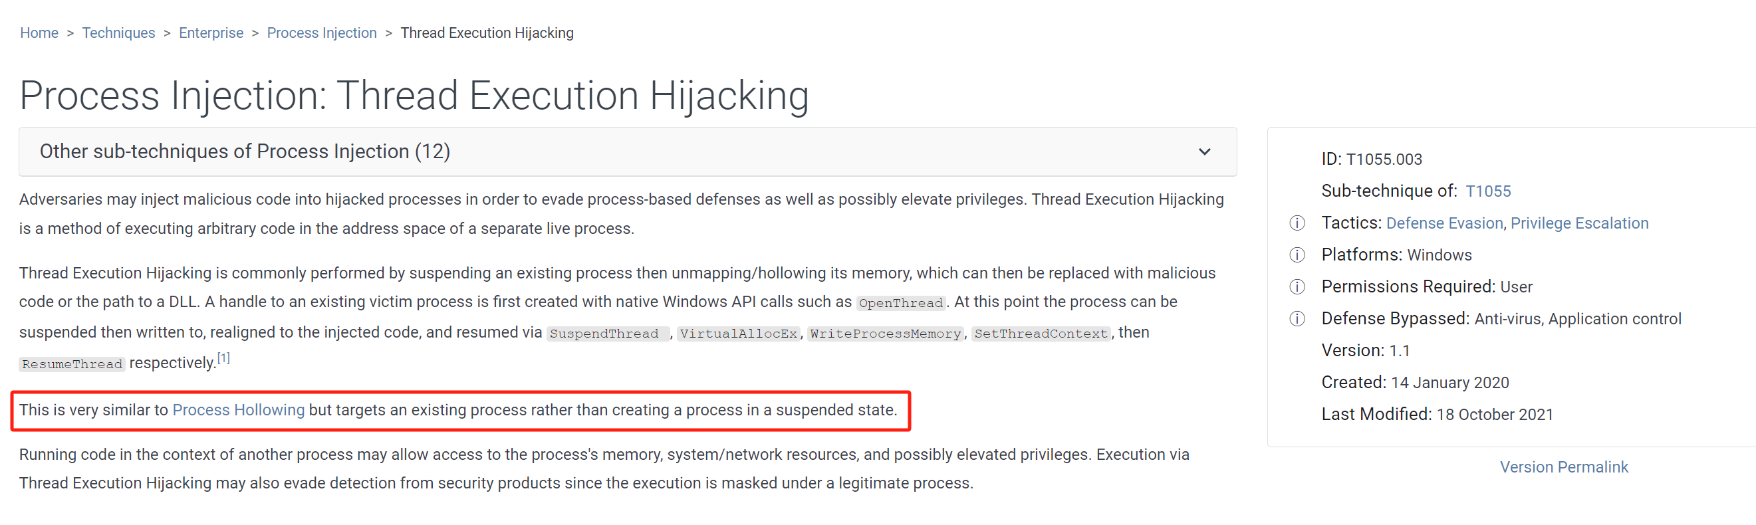
线程执行劫持（Thread Execution Hijacking）

Slide 49
Hook 注入（Hook Injection）

Slide 50
主观题
10分
讨论题：什么是Hook？是否只有恶意代码在使用Hook？
作答

Slide 51
Hook 注入
Windows是消息驱动的
例如游戏中的鼠标输入、键盘输入，通过消息机制与游戏程序交互
Windows hooks are used to intercept messages destined for applications（回调函数，消息响应函数）
恶意的hook注入
Ensure that malicious code will run whenever a particular message is intercepted
Ensure that a DLL will be loaded in a victim process's memory space

Slide 52
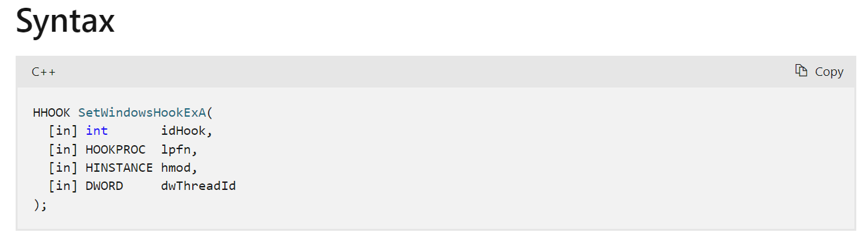
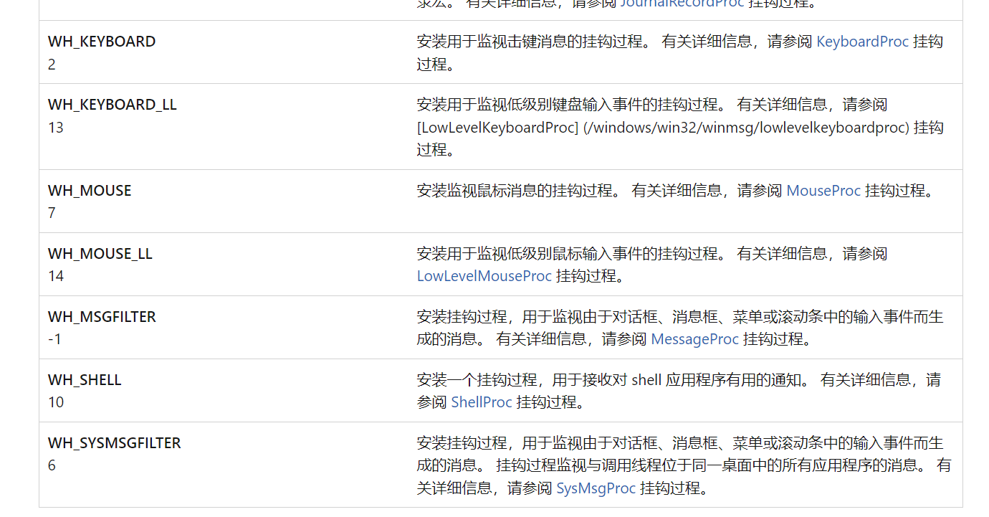
SetWindowsEx
idHook 挂钩类型
WH_CALLWNDPROC 在系统将消息发送到目标窗口过程之前监视消息
WH_CALLWNDPROCRET 在目标窗口过程处理消息后监视消息
WH_CBT接收对 CBT 应用程序有用的通知
WH_DEBUG 用于调试其他挂钩过程的挂钩过程
WH_FOREGROUNDIDLE 在应用程序的前台线程变为空闲状态时调用的挂钩过程
https://learn.microsoft.com/zh-cn/windows/win32/api/winuser/nf-winuser-setwindowshookexa

Slide 53
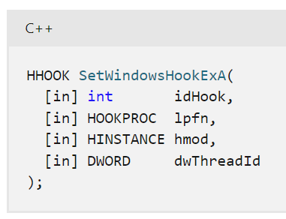
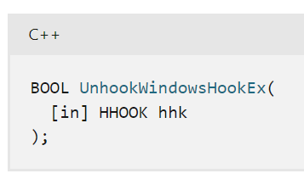
SetWindowsEx
lpfn
指向挂钩过程的指针。
hmod
DLL 的句柄，其中包含 lpfn 参数指向的挂钩过程。
dwThreadId
要与挂钩过程关联的线程的标识符
返回值 HHOOK
如果函数成功，则返回值是挂钩过程的句柄。
如果函数失败，则返回值为 NULL。
UnhookWindowsHookEx()

Slide 54
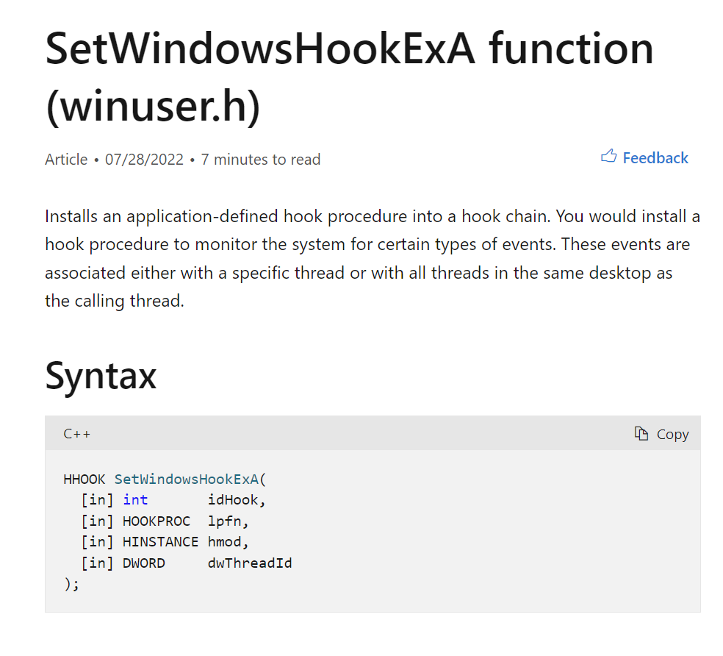
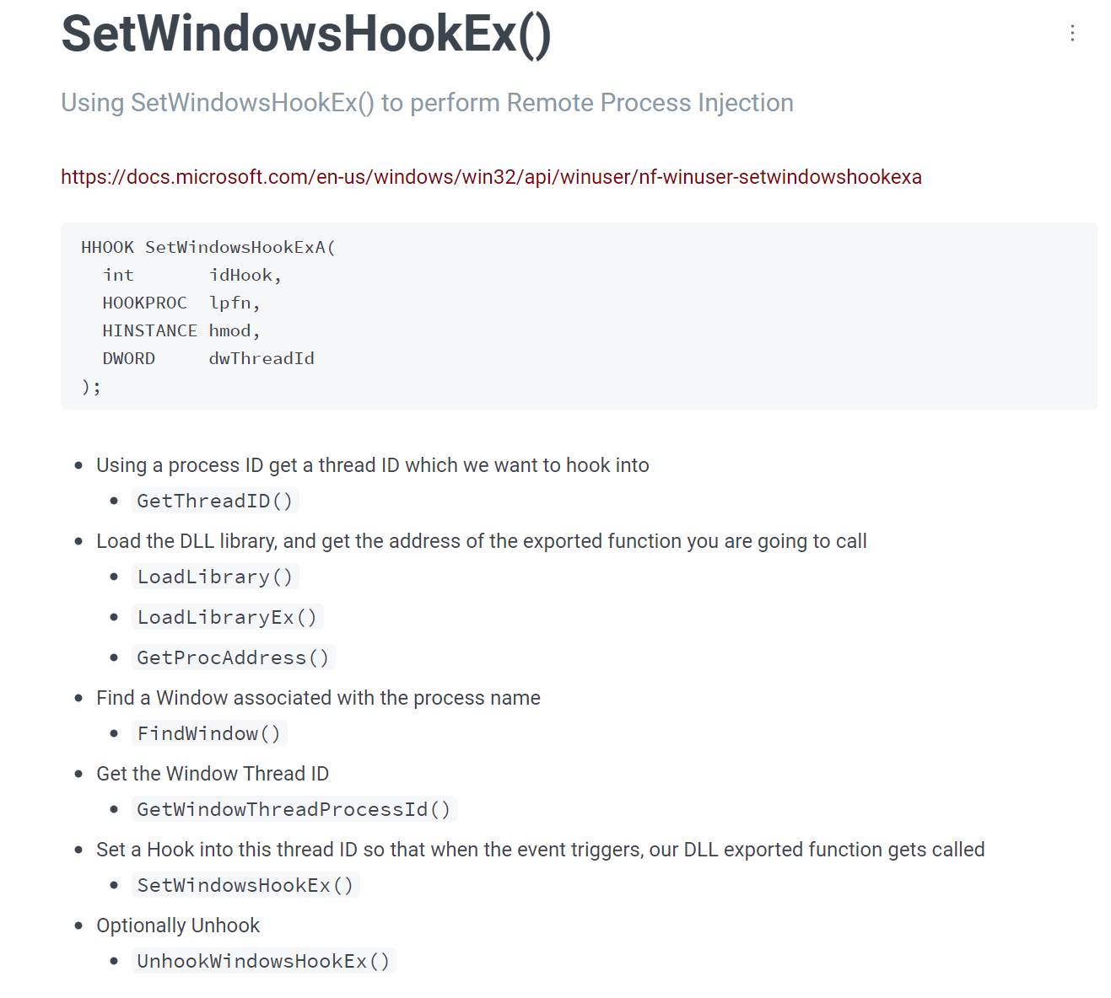
https://learn.microsoft.com/en-us/windows/win32/api/winuser/nf-winuser-setwindowshookexa

Slide 55
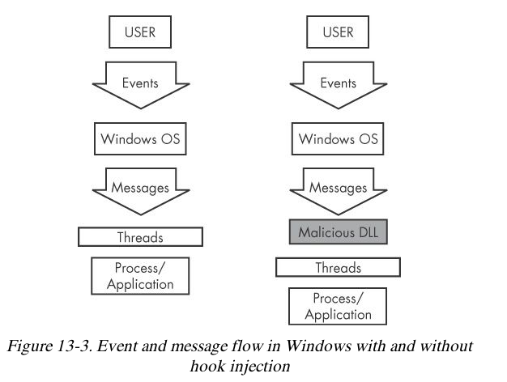

Slide 56
本地钩子和远程钩子
Local hooks observe or manipulate messages destined for an internal process
处理钩子所在进程的消息
Remote hooks observe or manipulate messages destined for a remote process (another process on the computer)
处理其它进程的消息

Slide 57
High-Level and Low-Level Remote Hooks
High-level remote hooks系统钩子
Require that the hook procedure is an exported function contained in DLL
Mapped by the OS into the process space of a hooked thread or all threads
系统开销大
Low-level remote hooks 线程钩子
Require that the hook procedure be contained in the process that installed the hook

Slide 58
Keyloggers Using Hooks
Keystrokes can be captured by high-level or low-level hooks using these procedure types
WH_KEYBOARD or WH_KEYBOARD_LL

Slide 59
SetWindowsHookEx
Parameters
idHook – type of hook to install
lpfn – points to hook procedure
hMod – handle to DLL, or local module, in which the lpfn procedure is defined
dwThreadId– thread to associate the hook with. Zero = all threads

Slide 60
钩子链（hook chain）
如果对同一个消息安装了多个钩子，多个钩子构成一个钩子链
The hook procedure must call CallNextHookEx to pass execution to the next hook procedure so the system continues to run properly

Slide 61
目标线程
Loading into all threads can degrade system performance
May also trigger an IPS
Keyloggers load into all threads, to get all the keystrokes
Other malware targets a single thread
Often targets a Windows message that is rarely used, such as WH_CBT (a computer-based training message)
同一个消息，既有high-level钩子又有low-level钩子，先执行low-level钩子

Slide 62
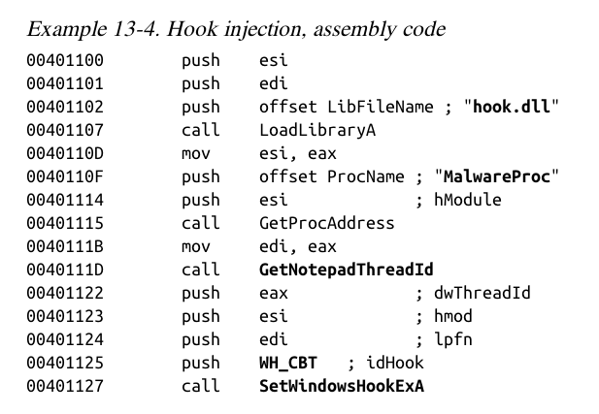

Slide 63
目标线程
Load malicious DLL hook.dll
Obtain hook procedure address
A WH_CBT message is sent to a Notepad thread
Forces hook.dll to be loaded by Notepad
It runs in the Notepad process space

Slide 64
单选题
10分
Which technique manipulates messages from a process to itself?
A
Local hook
B
High-level remote hook
C
Low-level remote hook
D
Keylogger
提交

Slide 65
单选题
10分
以下哪种方法会挂钩所有的线程?
A
Local hook
B
High-level remote hook
C
Low-level remote hook
提交

Slide 66
多选题
1分
以下哪个描述是正确的？
A
对于同一事件（如鼠标消息）既安装了线程钩子又安装了系统钩子，那么系统会自动先调用线程钩子，然后调用系统钩子。
B
对同一事件消息可安装多个钩子处理过程，这些勾子处理过程形成了钩子链。
C
当前钩子处理结束后应把钩子信息传递给下一个钩子函数。
D
系统钩子会消耗消息处理时间，降低系统性能。只有在必要的时候才安装钩子，在使用完毕后要及时卸载。
提交

Slide 67
多选题
1分
以下哪个描述是正确的？
A
钩子函数在完成对消息的处理后，要继续传递消息，必须调用CallNextHookEx来传递它，以执行钩子链表下一个钩子函数
B
钩子使用UnhookWindowsHookEx()卸载
C
SetWindowsHookEx()把钩子安装到钩子链表中
D
钩子的卸载顺序一定要和安装顺序相反
提交

Slide 68
Detours技术

Slide 69
Detours技术
Detours is a library developed by Microsoft.
easily instrument and extend existing OS and application functionality.
截获任意Win32函数调用的工具库
使用无条件转移指令来替换目标函数的最初几条指令，将控制流转移到截获函数。
Detours library is used by malware authors
modify important tables
attach DLLs
and function hooks

Slide 70
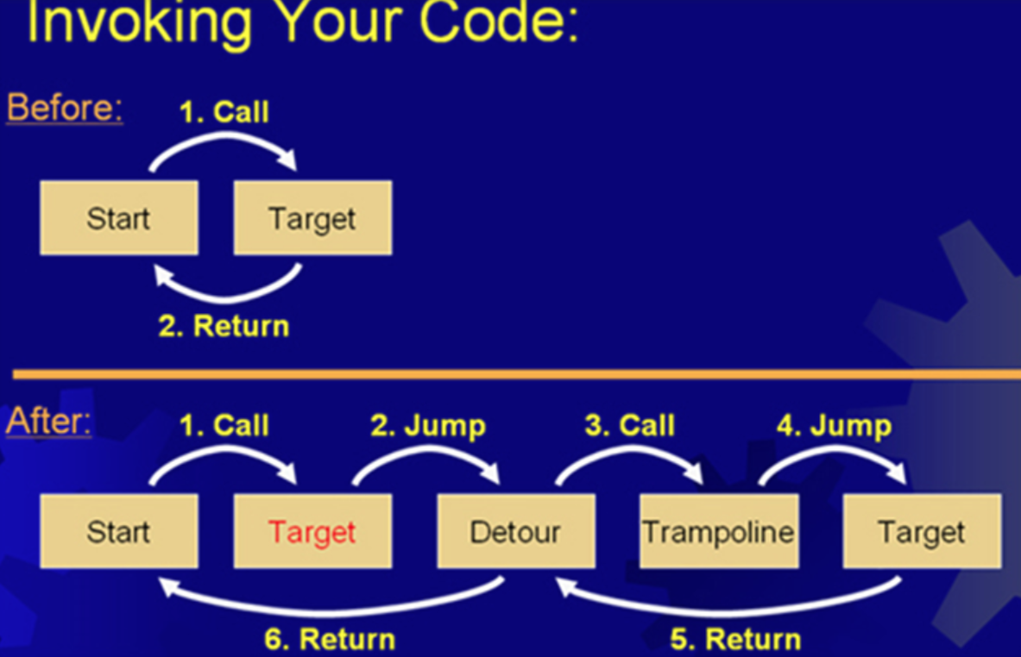
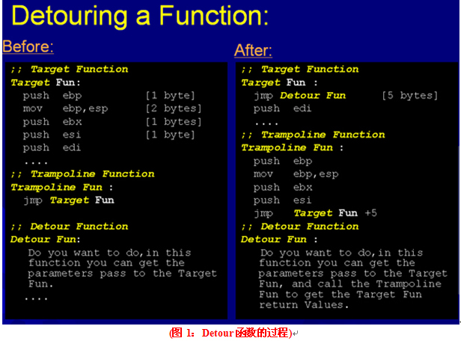
Detours
Target function, Trampoline function, Detour function

Slide 71
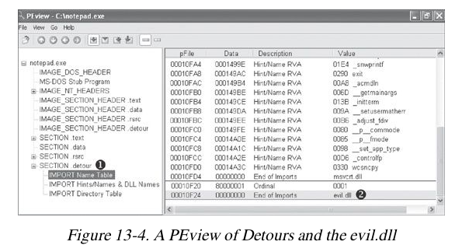
Detours技术

Slide 72
Trojanize notepad.exe
Create .detours section
Add a new import table
Contains evil.dll
Load evil.dll whenever notepad is launched.

Slide 73
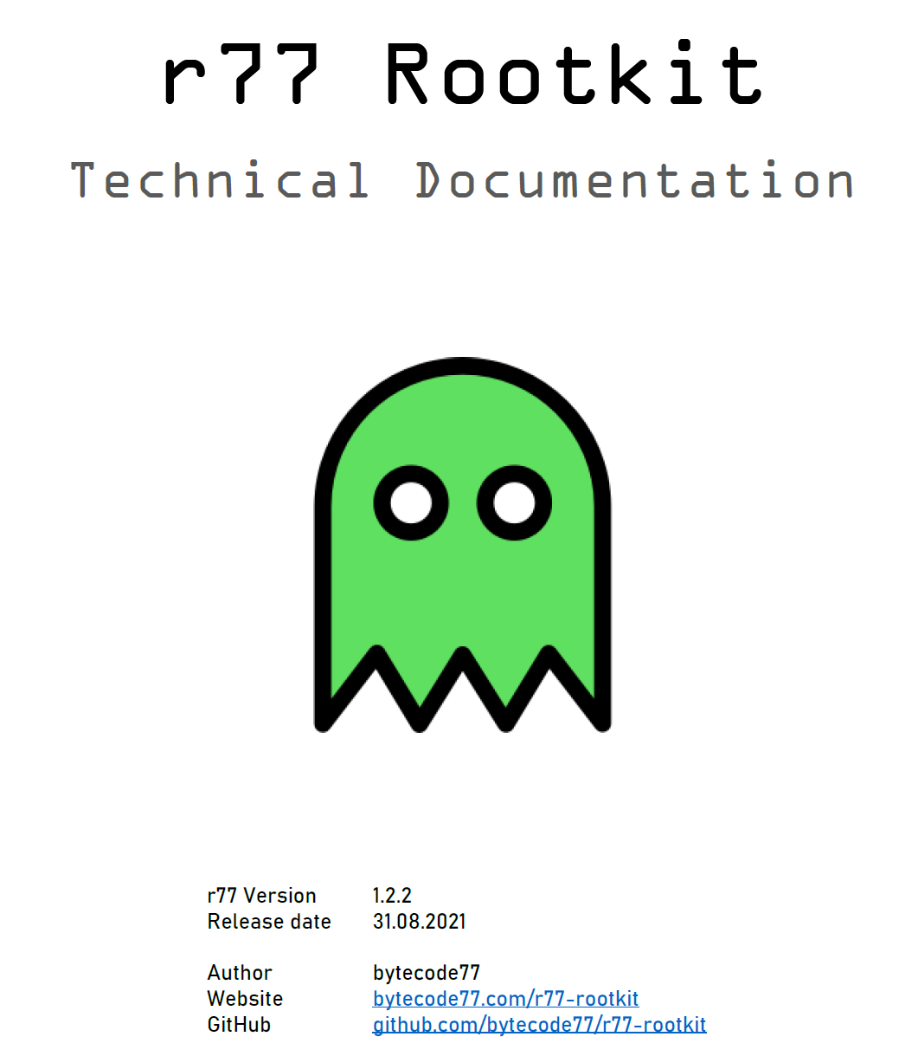
r77 Rootkit
Ring 3 Rootkit that hides following entities from all processes:
Files, directories, junctions, named pipes, scheduled tasks
Processes
CPU usage
Registry keys & values
Services
TCP & UDP connections
It is compatible with Windows 7 and Windows 10 in both x64 and x86 editions.
https://github.com/bytecode77/r77-rootkit

Slide 74
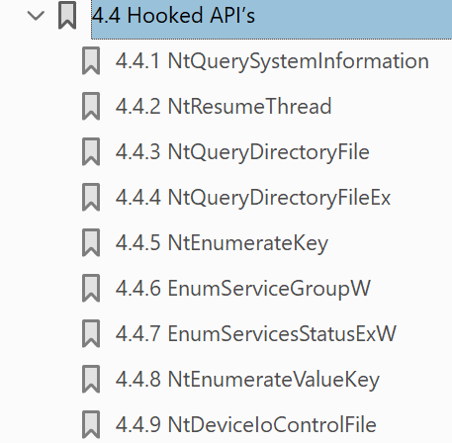
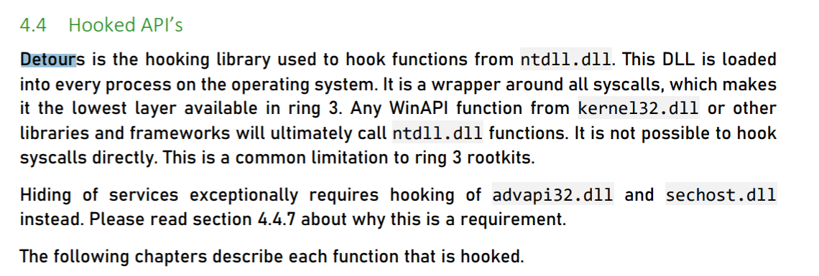
Detours技术

Slide 75
多选题
10分
下面哪种隐蔽方式是通过修改文件实现的？
A
Detour
B
DLL Injection
C
Direct Injection
D
Hooks
提交

Slide 76
APC注入（APC Injection）

Slide 77
Asynchronous Procedure Call (APC)
APCs (asynchronous procedure call) can direct a thread to execute some other code prior to executing its regular execution path.

Slide 78
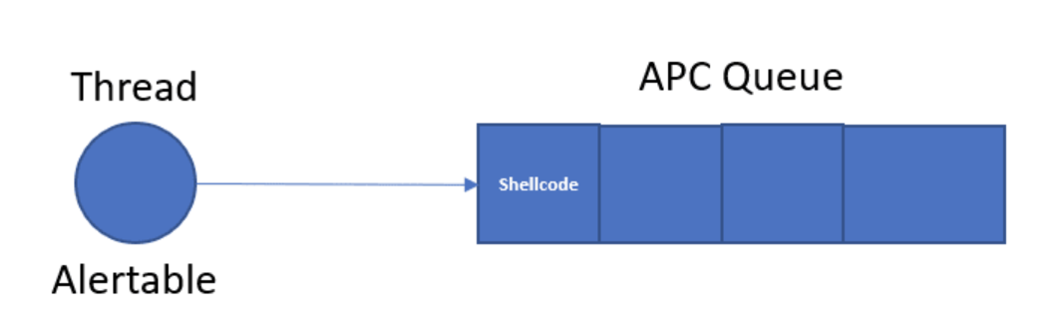
APC 注入
Every thread has a queue of APCs, and these are processed when the thread is in an alertable state
SleepEx, SignalObjectAndWait, MsgWaitForMultipleObjectsEx, WaitForMultipleObjectsEx, WaitForSingleObjectEx

Slide 79
APC 注入
When in altertable state, the thread calls the APC functions one by one for all APCs in the queue.
When the APC queue is complete, the thread continues running along its regular execution path.

Slide 80
APC 注入
内核模式APC（Kernel-Mode APC）
Generated for the system or a driver
用户模式APC（User-Mode APC）
Generated for an application
APC Injection is used in both cases

Slide 81
用户模式APC 注入
Uses API function QueueUserAPC to queue a function to a remote thread
Thread must be in an alterable state
WaitForSingleObjectEx is the most common call in the Windows API
Many threads are usually in the alterable state

Slide 82
QueueUserAPC
hThread handle to the victim thread
pfnAPC defines the function to run
dwData parameter for the function

Slide 83
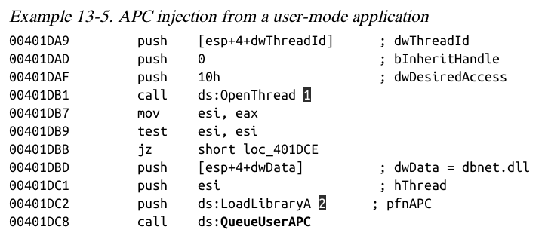
Obtain the handle to the victim thread
QueueUserAPC is called with pfnAPC set to LoadLibraryA (loads a DLL)
dwData contains the DLL name (dbnet.dll)
Svchost.exe is often targeted

Slide 84
内核模式APC注入
Malware drivers and rootkits often want to execute code in user space
One method is APC injection to get to user space
Most often to svchost.exe
Functions used:
KeInitializeApc
KeInsertQueueApc

Slide 85
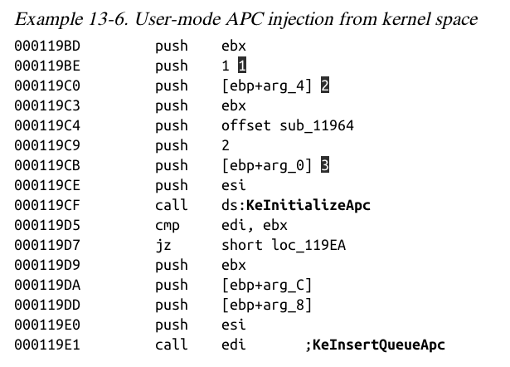

Slide 86
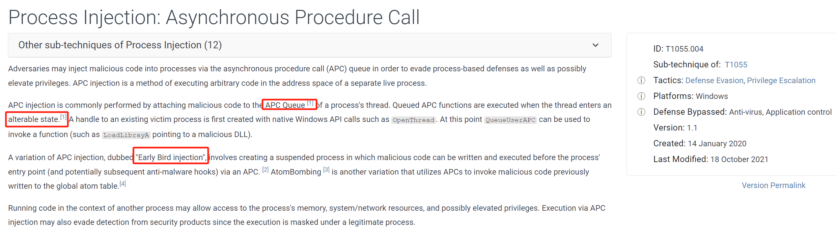
T1055.004

Slide 87
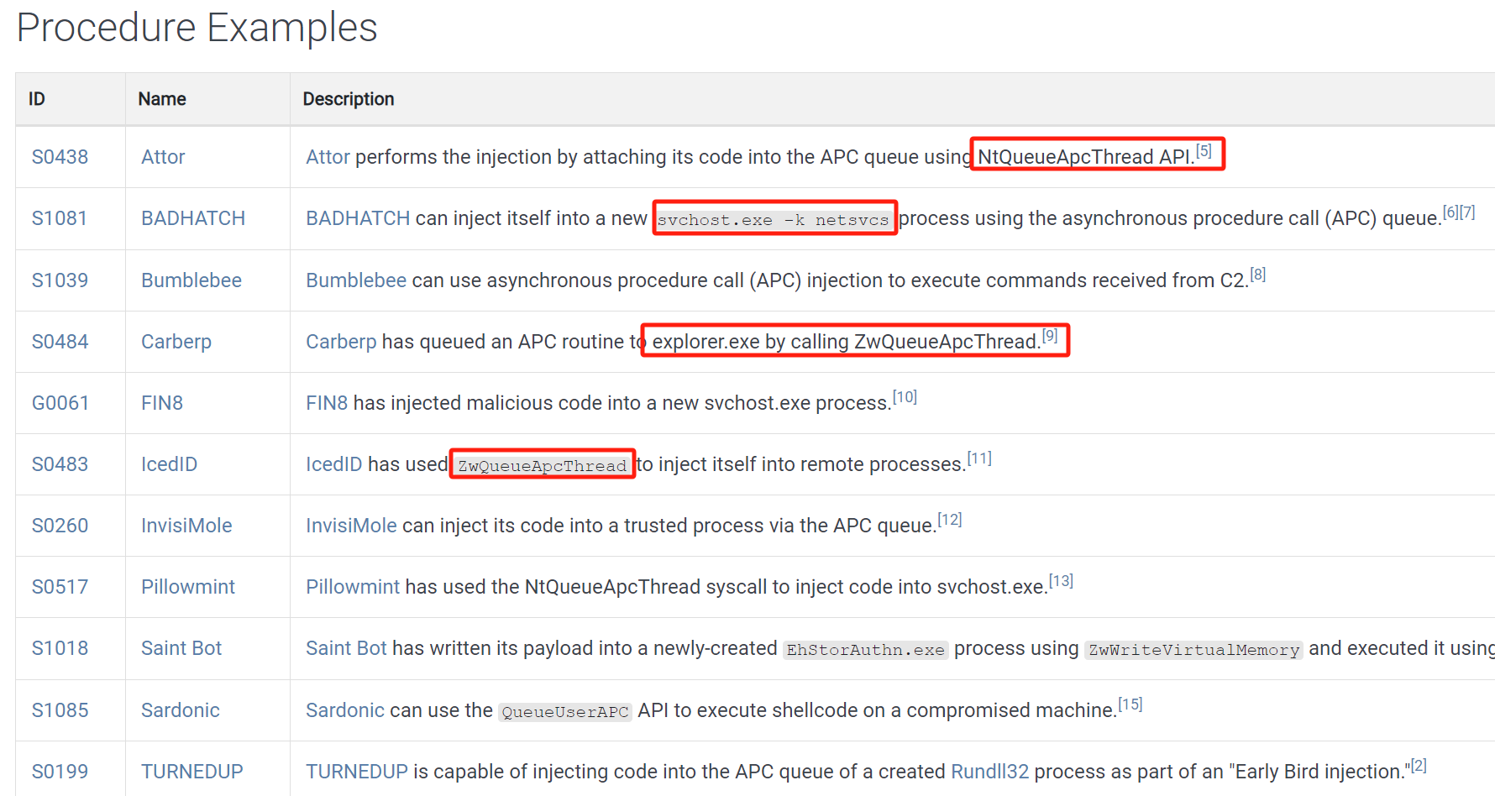
ACP注入的案例

Slide 88
主观题
10分
讨论：如何防治或者缓解APC注入攻击？
作答

Slide 89
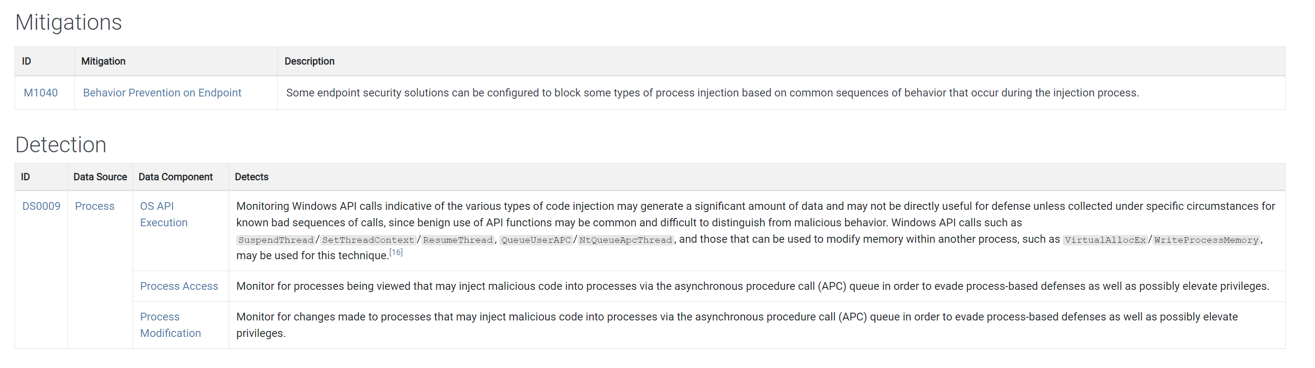
APC注入攻击的防治

Slide 90
单选题
10分
Which technique only works for threads in an alterable state?
A
Detours
B
APC
C
Hook
D
Injection
提交

Slide 91
单选题
1分
APC注入只能用于用户空间的程序，不能用在内核空间。
A
正确
B
错误
提交

Slide 92
知识点
启动器（Launchers）
进程注入（Process Injection）
重点：DLL注入、直接注入
进程替换（Process Replacement）
难点：Suspended State
Hook注入（Hook Injection）
难点：Local Hook、Remote Hook
Detours技术
难点：R77
APC注入（APC Injection）
难点：Alertable State

Slide 93
恶意代码分析与防治技术 第12章 隐蔽执行技术
王志
zwang@nankai.edu.cn
南开大学 网络空间安全学院
2023-2024学年

